Slide 1
State Accounting Business User Group (BUG)
Thursday, May 23, 2019
9:00 AM – 11:00 AM
1526 K Street basement, Training Room/Development Center

Slide 2
Agenda
Announcements
General Announcements
Use AS.State Accounting email for requests, do not send to individual email
Deactivation of user IDs upon employee termination
Presentations
State Accounting website/Training Guides/Accounting Manual
Encumbrance/Carryover Process
SEFA (Schedule of Expenditures of Federal Awards)
Purchase Order Cleanup
Fixed Assets
Fiscal Year End Schedules
Financial Reporting Package/Accruals Reports

Slide 3
Announcements
General Announcements
Use AS.State Accounting email for requests, do not send to individual email
Deactivation of user IDs upon employee Termination
http://das.nebraska.gov/personnel/user_guides/ewoc/terminateanemployee.pdf

Slide 4
Encumbrances
Sheryl Hesseltine

Slide 5
What is an encumbrance?
Financial obligations which are chargeable to a specific biennium’s appropriation and for which a part of the appropriation is reserved.
Policy based on Statutes 81-138.01 – 81-138.04
In simple terms: an encumbrance is a reservation of an appropriation

Slide 6
Certified Encumbrances
Valid encumbrances that an agency chooses to reserve to meet a future financial obligation.
Agencies will review their Biennial Carryover Report as of 7/31 and 8/14. The 8/31 Biennial Carryover Report will be signed by agency director and sent to State Accounting and this certifies the encumbrances.

Slide 7
Valid Encumbrance: 81-138.01
A purchase order is issued, but the goods and accompanying invoice were not received and paid during the same biennium
Goods or services were received, but an invoice has not been received and paid
Goods or services and an invoice were received, but payment could not be made during the same biennium

Slide 8
Valid Encumbrance: 81-138.01
Salaries have been earned and are payable to the employees, but have not been paid as of the end of the biennium as a result of pay periods not being consistent with the end of the biennium, except that higher education institutions may encumber payrolls for the remainder of the summer session which is in progress at the end of the state’s biennium if they have been budgeted and appropriated in such manner

Slide 9
Valid Encumbrance: 81-138.01
A written agreement for a grant or award to distribute aid was signed but was not paid during the same biennium

Slide 10
Four ways to identify prior year obligations
Prior Year Voucher Without PO (P9 transaction)
Prior Year Voucher With PO (P9 transaction)
Manual Encumbrances (J9 transactions in PB ledger)
Automatic Encumbrances (Open purchase orders at year end)

Slide 11
Prior Year Voucher Processing Menu
Use the prior year voucher processing menu throughout the year
Accounts Payable>Prior Year Voucher Processing>PY Voucher Entry
This is used to identify all accounts payable where goods or services were received in the prior fiscal year
The encumbrance process uses these P9 transactions so agencies do not have to enter them again for encumbrance certification.

Slide 12
Manual Encumbrances
Can be entered in two different places
Budget Menus:
Budget>Enter/Adjust Manual Encumbrances>Enter/Adjust Manual Encumbrances
Accounting Menus:
Accounting>Manage Journal Entry>Enter Manual Journal Entries>Journal Entries with Debit/Credit Format

Slide 13
Enter J9 in the Doc Type/No/Fd field
The Ledger Type field defaults to PB

Slide 14
Enter J9 in the Doc Type/No/Fd field
Change the Ledger Type from AA to PB

Slide 15
Manual Encumbrance Steps
Use Doc Type J9
G/L Date must be today’s date
Provide explanation: such as ‘To encumber prior year’
Use Ledger Type PB
Transaction must be APPROVED, PREAUDITED AND POSTED in the month created

Slide 16
Liquidating a Manual Encumbrance
E1 Training Guides
http://link.nebraska.gov
User Guides in Help section at bottom of page
Payroll and Financial Center
Budgeting
Lesson 1: Working with Transactions
Use the void journal entry process. Make sure to use a current G/L Date, and approve and post the batch right away

Slide 17
Manual Encumbrances
Manual encumbrances affect the current authority
State Accounting will prepare and enter the payroll encumbrances this year
Entry will be based on 100% of July 3rd payroll and 50% of the July 17th payroll
Will not include Health, Life and AD&D insurances
Encumbrance entry will be done after July 17th payroll has posted
You will see them on your allotment status and budget status reports until they are liquidated after the certification process

Slide 18
Manual Encumbrances
Manual encumbrances can be used to offset other encumbrances
If a purchase order for June 30 has the incorrect amount or should not have been open at June 30, a negative manual encumbrance (credit amount) can be used to offset the encumbrance
If a document is incorrectly created as a prior year obligation (P9), a negative manual encumbrance (credit amount) can be used to offset the encumbrance (a negative manual encumbrance will show on your current allotment status report as a negative amount)
If a document is incorrectly created as a current year obligation (PV), a manual encumbrance (debit amount) can be used to create the encumbrance

Slide 19
Automatic Encumbrances
Purchase Orders that were open at June 30
State Accounting takes a “snapshot” of all open purchase orders at June 30 and records that information in the PC ledger

Slide 20
Automatic Encumbrances
It is very important that agencies complete a review of Open Purchase Orders before June 25 to ensure all orders are valid
These will be rolled over into July 1, 2019
If there is a problem, contact State Accounting by email at as.stateaccounting@nebraska.gov with a subject line of PO followed by the purchase order number, order type and line number

Slide 21
Encumbrance Detail Report
As you are entering manual encumbrances, you can use this report to ensure that your encumbrances are recorded correctly
Available from two menus in E1:
Accounting>Inquiries & Reports>Budget Reports>Other Budget Reports
Budget>Inquiries & Reports>Budget Reports>Other Budget Reports

Slide 22
Century: no changes
Ending Fiscal Year: the year just completed (2018)
Last transaction date: usually the last date of the month you are reviewing
Put in your Agency number

Slide 24
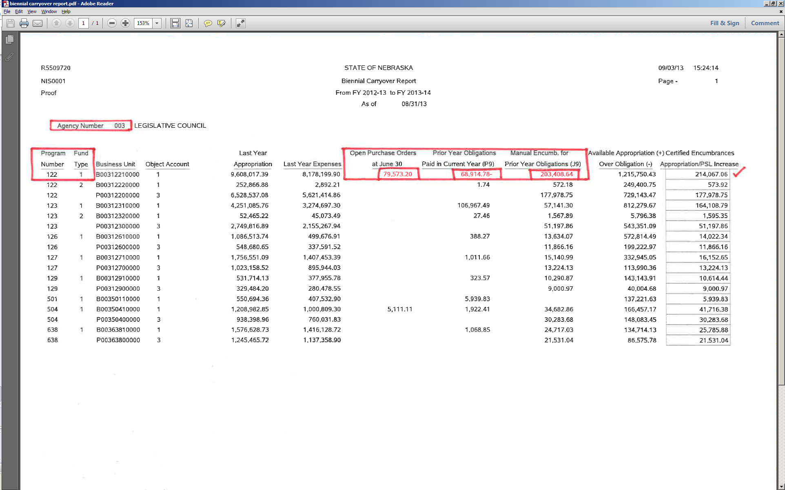

Slide 25
Biennial Carryover Report
This will be run according to Fiscal Year End Closing Schedule
As of 8/1/2019 – agency review for corrections
As of 8/15/2019 – agency review for corrections
As of 9/3/2019 – this will be the Certified copy, director signature, submit by Sept 16, 2019
Totals should match Encumbrance detail report and should be only valid encumbrances

Slide 26
Questions?
http://das.nebraska/accounting
Administrator’s Correspondence; closing schedule
Accounting Policies; state accounting manual (section 11, encumbrance policy)
http://www.nebraskalegislature.gov/laws/browse-statutes.php ; statutes 81-138.01 – 81-138.04
Sheryl Hesseltine
sheryl.hesseltine@nebraska.gov
402-471-0610

Slide 27
Schedule of Expenditures of Federal Awards (SEFA)
Sheryl Hesseltine

Slide 28
SEFA
Agencies that receive Federal funds will get an email from State Accounting to verify the amount of Federal expenditures and sub-recipient expenditures in E1 for each federal award.
An email will be sent around the first of July and a response will be due within a month.

Slide 29
Fiscal Year End & Purchase Orders
Andrea Kiichler

Slide 30
Open Purchase Order’s
Service Purchase Orders with a document type O9 or Z8 must be zeroed out or cancelled.
Add line to the PO with a negative amount to offset the remaining balance
The negative line may then be cancelled in July to restore the purchase order
Cancel PO’s that will never be received against

Slide 31
Open PO report-Buyer #
State of NE->Purchasing-Agencies->Inquiries and Reports-> Purchasing reports->
Procurement Reports-> Open PO detail by Reference:
Notes:
This report shows open PO’s by buyer #. Can list one or multiple buyer #’s for this report.

Slide 32
Open PO Report-Business Units
Purchasing - Agencies->Inquiries & Reports->Purchasing Reports ->Procurement Reports ->Open PO Detail by Branch/Plant
OR
Accounting-> Inquiries & Reports -> Accounting Reports->Encumbrance/PO Reports->Open PO Detail by Branch/Plant
Notes:
E1 strings, BU detail type. 2 different pathways, same report options
This report gives the option of open PO’s by BU.

Slide 33
Remember……
All Service type purchase orders must be closed out or cancelled before 6/25
Create negative line on PO’s if services will not be received by 6/25, can cancel negative line after close of fiscal year
Verify that PO’s that will never be receipted against are cancelled out

Slide 34
Fixed Assets
Andrea Kiichler

Slide 35
Procurement
Planners: setting stage with PO creation
Detail lines most important:
Single or multiple items
Fixed Asset object code “58”
Payees:
3 way match and O Batch
(let this post before PV!)
Creates first relationship with Fixed Assets & G/L
Adds transaction to Unposted FA report
Accounting
Fixed Assets
Foundation of the asset (multiple people)
Create the Asset Masters
Monthly review of Unposted FA Transaction report & FA No Cost Integrity report
Post costs to Assets
Notes:
The 3 Pillars of an asset:
Procurement: Single or Multiple PO lines: single line-easy post for FA, one line with multiple items will be a FA split to assign costs to each item
Accounting: starts with receipting of the PO. Receipting PO creates OV batch, make sure this has posted before the PV batch is created.
Fixed Assets: begins with creating the Asset Master

Slide 36
Creating an Asset Master

Slide 37
The Fixed Asset tag number should match the agency and division. The tag number should also match the responsible business unit.
(In this example, agency 65)
Fund:
Not sure? Skip to responsible BU, use magnify glass to search for fund paired to BU.
Account #: fund # and 17xx00
xx=from digits 3 & 4 in the OC
Ex. 65070009.583470
Acct # for FA= 56520.173400
Remember to enter PO #
Notes:
Start with FA Tag #
How to find fund
Acct #-how to find. Next slide-why is this important?

Slide 38
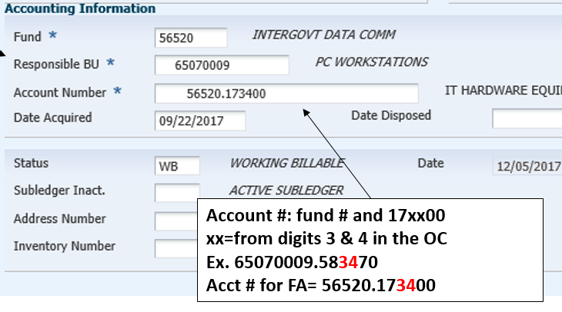
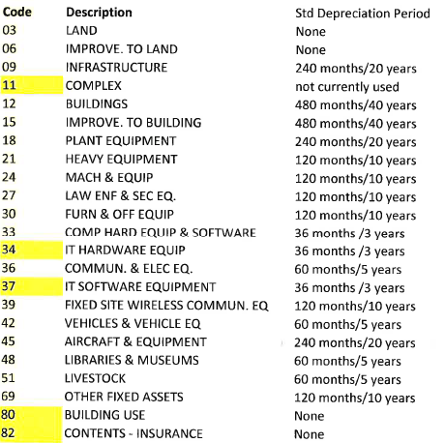
Notes:
Within the Acct #, #’s 3 and 4 relative to 2 parts of the asset *Depreciation-see coding
*Item Code-next slide

Slide 39
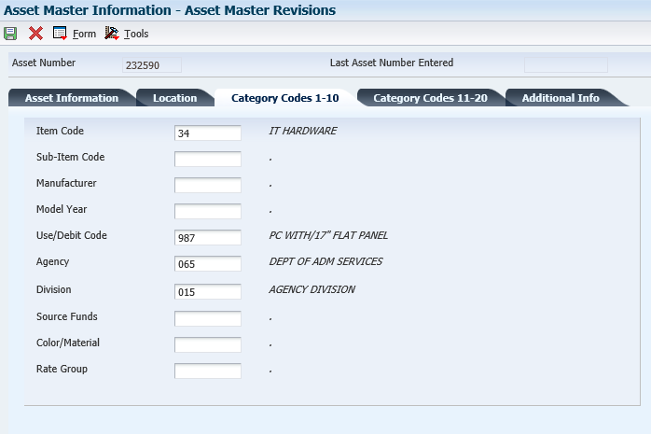
Item Code: auto filled from the Asset info tab
Both must be entered

Slide 40
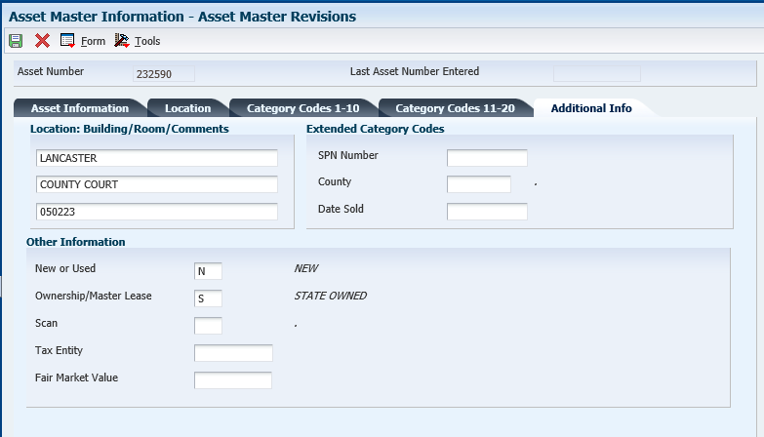
Both fields should be entered
Notes:
Save Asset Master. E1 will then auto assign an asset # to the TAG you just created.
More details in the E1 training guides

Slide 41
I used the wrong Business Unit when I created the Asset Master!!
Deep breaths! As long as no cost has been assigned to your asset, delete the record and create a new one.

Slide 42
Fixed Asset Reports

Slide 43
Unposted Fixed Asset Report
Review or print all transactions which have been posted in the General Ledger, but have not yet been posted to a fixed asset
(shows OV receipt batches, used for JE entry reference)
Simply: costs coded to fixed asset object code
& have been receipted or entered as JE

Slide 44
Notes:
Two receipts, OV batches, posted to report

Slide 45
Fixed Asset No Cost Integrity Report
Review or print any assets that are missing costs associated with the asset.
Goal is to have this report blank, kept as short as possible, and with only recently acquired assets
Simply: asset master has been created, but no costs are attached

Slide 46
Notes:
If you discover that this report has multiple assets listed, it is possible that an error may have occurred. Ex. Cost might have been “passed” on, and not posted to the asset. Need to review the Asset Master Record, and purchase order to determine if costs need to be posted.
*The F/A No Cost Report & Unposted FA Report should be reviewed monthly. Unposted FA should be cleared at end of every month.

Slide 47
Posting Costs to an Asset

Slide 48
State of NE -> Fixed Assets -> Post Fixed Asset Transactions-> Revise Unposted F/A Entries
Doc #: found on Unposted Fixed Asset report, part of the OV batch
Add Tag # to asset
Row - Revise entries-enter Tag # and save
Final Step: Row -> Post -> Save
Notes:
*Master Asset Record must be created before you can post the cost to the assets.
*Doc number from Unposted Fixed Asset report, will pull up receipt entry.
*Row, revise entries to add tag # to entry
**Row, Post, and Save.
Hit hourglass to refresh this screen, your unposted should disappear.

Slide 49
Asset Master-> Asset Balance Info -> Cost Summary
Notice account #’s- both list the “34”
Value of asset posted
Notes:
This is what your asset should look like in E1 when cos

Slide 50
Split Asset Transaction
Doc #: found on Unposted Fixed Asset report, part of the OV batch

Slide 51
Amts. should balance when you hit “save” after all entries
Import excel sheet for multiple entries
Add Tag # to each line

Slide 52
Posting costs to an asset need to be completed within the same month as the receipt!
If they are not, a JE must be completed in order to post the costs
Allow ample time between receipting and posting costs to fixed assets
Ex. 5 days before month end, do not receipt any fixed assets!

Slide 53
Fixed Assets: prior month cost posting
Compare the “Fixed Asset No Cost Integrity” report & “Unposted Fixed Asset” report.
Find the cost on the “Unposted Fixed Asset” report (this is an “OV” receipt batch) that aligns with “Fixed Asset No Cost Integrity” report tags.
Notate the document # on the “Unposted Fixed Assets” report

Slide 54
Creating your JE State of Nebraska->Accounting-> Manage Journal Entry-> click on “+”
Enter 2 leading zeros for PO #
Why JE is needed
OV # and G/L date is from your Unposted FA report
Attach supporting documentation for JE entry
ex.: PO and invoice, and other specific notes
Notes:
TIME SAVER: Can import an excel sheet to upload to the JE
Save, and note the batch # of your JE
Once JE is created, 2 parties other than yourself, should approve, and then post the JE batch.

Slide 55
JE approved and posted
Run Unposted Fixed Asset report, and note the document # related to your JE
E1 String:
State of Nebraska>Fixed Assets>Post Fixed Asset Transactions>Revise unposted fixed asset entries
Enter document # from the new Unposted Fixed Asset report, search.

Slide 56
Step 1: Select all DR entries; these costs will be posted.
Row->Post
Tag #’s should be listed here, if not, verify that an Asset Master was created
Step 2: Select CR tab.
Row->revise entry.
Notes:
Once the Dr have been posted, refresh screen. Only CR should show.

Slide 57
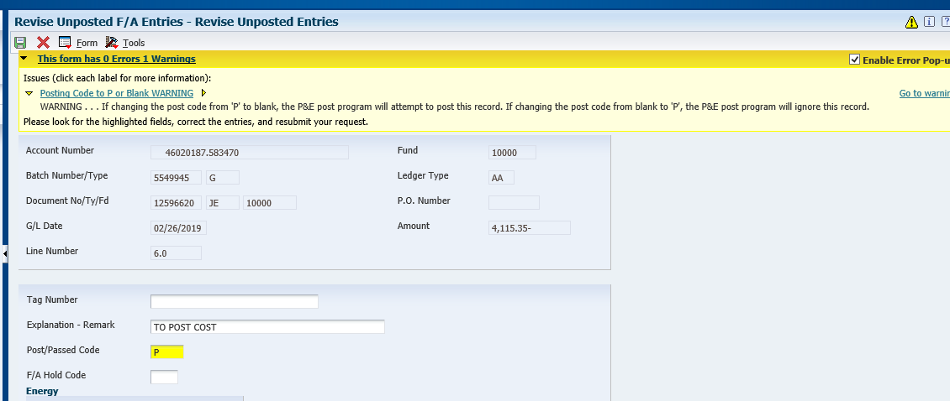
Notes:
When passing on CR, yellow message box appears,
If changing from “blank” to “P” E1 will ignore this record. OK to hit OK again, this is what we want it to do.

Slide 58
Original Unposted fixed asset report, locate the original OV doc #, that was created when the PO was receipted against.
Using the Revise Unposted FA Entries screen, pull up the original OV doc #. Pass on these costs. Notate in description reason for passing on costs.
This will remove the OV receipt entries items from the unposted FA report.
The JE that was created to post costs to the asset replaces the OV Receipt. This is why we are passing on the costs.

Slide 59
Oops! I posted both my DR and CR transactions, now what?
If you accidentally zero out the costs for your fixed asset, by selecting the debit and credit row, then you’ll need to create a new journal entry since the amounts are now zeroed out. State Accounting CANNOT undo this mistake if you post the costs incorrectly. You will have to complete a NEW journal entry.

Slide 60
Summary
Fixed Assets have a direct relationship with Procurement and Accounting functions
Asset Master must be created before costs posted to asset
Post the cost in the same month that the PO is receipted
“Split” FA Transactions for multiple items, 1 PO line
Previous month not posted, JE entry
Monthly review of Unposted FA report and FA No cost integrity report

Slide 61
Questions?

Slide 62
Fiscal Year End Schedule
Shannon Muffly

Slide 63
Monday, June 3, 2019
Review open manual encumbrances
Review Service PO’s (O9, Z8, or X6)
Review of Received Not Vouchered (211700)
Open Purchase Orders
Petty cash funds and vendor deposit accounts
Review of all balance sheet accounts (100000-399999)

Slide 64
Thursday, June 13, 2019
Bi-weekly payroll (B13) due for certification

Slide 65
Tuesday, June 25, 2019
Unposted Fixed Asset Report
Fixed Asset No Cost Integrity Report
All Service PO’s (O9, Z8, or X6)
Manual Encumbrances
Allotment Status Report
Review any outstanding cash transactions related to the Treasurer’s office
LAST DAY TO POST FISCAL YEAR END 6/30/19 TRANSACTIONS
5:00 P.M. – Procurement Roles will be taken away

Slide 66
Wednesday, June 26, 2019
No purchasing activity without authorization from Sheryl Hesseltine. Do not perform a receipt function against an outstanding purchase order for current period or a future period unless authorized since these must be posted before year-end.
Only volume voucher payments and emergency payments.
Line Type 4
Expenditures for E1 Fiscal Year 18 (July 1, 2018 to June 30, 2019)

Slide 67
Thursday, June 27, 2019
Only volume voucher payments and emergency payments
Only Expenditures for E1 FY 18 w/prior notification and approval
Bi-weekly payroll (B14) due for certification

Slide 68
Friday, June 28, 2019
Treasurer’s Office cut off for deposits – 9:00 A.M.
No purchasing or posting activities
If there are outstanding issues for your agency that will have a financial impact, contact Sheryl Hesseltine by 12:00 P.M.
E1 will be shut down for all agencies at 3:00 P.M.
Outstanding purchase orders (not received)

Slide 69
Monday, July 1, 2019
NO POSTING UNTIL FLASH MEMO IS RECEIVED THAT YEAR END CLOSE IS COMPLETE – ANTICIPATED BY MONDAY, JULY 1, 2019 AT 7:00 A.M.
First allotment of new fiscal year appropriations
Prior year voucher processing
July 1, 2019 Allotment Status Report
Review open Purchase Orders

Slide 70
Wednesday, July 3, 2019
Prior year manual encumbrances that were voided (to be carried over) may be re-entered
Start entering valid manual encumbrances
Encumbrance Detail Report

Slide 71
Wednesday, July 17, 2019
State Accounting will calculate accrued payroll based on July 3rd and July 17th biweekly payrolls
July 3rd payroll is 100% June hours
July 17th payroll is 50% June hours
Contact State Accounting if you use a different method or have questions

Slide 72
Wednesday, July 31, 2019
Complete entry of E1 Fiscal Year 19 budgeted amounts for the Budget Status Report

Slide 73
Biennial Carryover Reports
First draft as of Wednesday 7/31/19 – run on Thursday, August 1, 2019
Second draft as of Wednesday 8/14/19 – run on Thursday, August 15, 2019
Certified version as of 8/31/19 – run on Tuesday, September 3, 2019
Certified Biennial Carryover Report (signed copy) due to State Accounting by Monday, September 16, 2019
Blank reports must be sent in as well

Slide 74
Monday, September 30, 2019
State Budget division completes review of certified encumbrances
Re-appropriation
After certification process completed, State Accounting will liquidate payroll encumbrances

Slide 75
Reminders
Shannon Muffly

Slide 76
Reminders
Financial Reporting Package
Sent to all agencies first week of July, due to Shannon Muffly by August 9, 2019
AS State Accounting email for Fund Requests and Investment Authorizations
Month End Close – transactions needs to be posted or voided before NOON on the first business day of the month.

Slide 77
Questions?
http://das.nebraska/accounting
Administrator’s Correspondence; closing schedule
Accounting Policies; state accounting manual (section 11, encumbrance policy)
http://www.nebraskalegislature.gov/laws/browse-statutes.php
statutes 81-138.01 – 81-138.04
Contact Info
sheryl.hesseltine@nebraska.gov, 402-471-0610
andrea.kiichler@nebraska.gov, 402-471-6621
shannon.muffly@nebraska.gov, 402-471-0616
kevin.le@nebraska.gov, 402-471-0622

